Slide 1
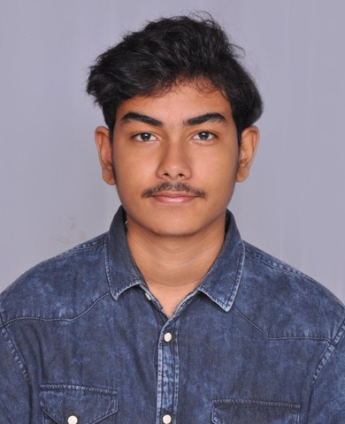
Executive Profile
Picture
Summary
Technical Expertise
DevOps Engineer with 1+ year experience i have developed skills in DevOps ,Cloud and Development and I want to apply my knowledge in the field of Devops and Software Development to cater to the specific needs of the people. I wish to work in a team of motivated individuals who wish to work towards the advancement of the company and its goals.
Experience on installation of tools like GIT, Jenkins, Maven, Ansible,Terraform,Docker, Docker-compose and Kubernetes on Linux and Windows environment
Experience in GIT (GitHub) as SCM tool – Creating and managing repositories, branches, tags – Setting up branch policies and working or pull requests and code merging.
Hands-On experience in CI (Continuous Integration) and CD(Continuous Deployment) methodologies with Jenkins.
Build Management – Experience in handling build tools like Maven for Java, .Net Core SDK for .Net, NPM for NodeJS applications – Performed Automation builds.
Skilled in programming like python,HTML,CSS, JavaScript and C#, Databases like SQL ,operating systems like Windows and Linux, and web applications​
Skilled in problem-solving, prioritizing, and decision-making​.
Kandula Venkata Tarun
Technical Skills
Cloud Platform : AWS
Tools : Github, Gitlab , Ansible and Terraform
Build Tools : Maven.
CI/CD Tools : Jenkins.
Systems : Windows and Linux
Scripting Language : Bash scripting.
VMs : Oracle VM and Vagrant.
Container : Docker and Kubernetes .
Programming knowledge : Python,HTML,CSS, and JavaScript
Others : C# , .Net core and SQL
Education
Bachelor of Computer Science and Engineering

